Slide 1
THE CLIFF EFFECT ONE STEP FORWARD, TWO STEPS BACK
Symposium:
On Removing Barriers to Economic Mobility
Notes:
Thanks so much for joining us to discuss the Cliff Effect Report.
We’ll begin by pointing out some relevant background information and then discuss some of the findings from the report.

Slide 2
Thank You!
As Indiana’s oldest and largest community foundation, The Indianapolis Foundation (a CICF affiliate) was created in 1916 to ensure that the quality of life in Marion County continuously improves; to help where the needs are greatest and the benefits to the community are the most extensive; and to provide donors a vehicle for using their gifts in the best possible way now, and in the future as conditions in the community change.
www.cicf.org/the-indianapolis-foundation

Slide 3
Thank You!
The National Center for Children in Poverty (NCCP) is one of the nations' leading public policy centers dedicated to promoting the economic security, health, and well-being of America’s low-income families and children. NCCP uses research to inform policy and practice with the goal of ensuring positive outcomes for the next generation. We promote family oriented solutions at the state and national levels. http://www.nccp.org/

Slide 4
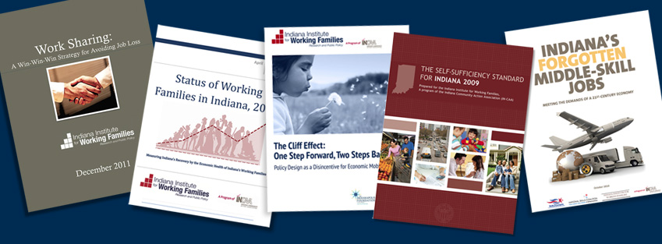
About Us…
The Indiana Institute for Working Families
The Indiana Institute for Working Families conducts research and promotes public policies to help Hoosier families achieve and maintain economic self-sufficiency.
A Sample of our Work
Notes:
We hope you’re familiar, or will become more familiar with our logo. We are a program of the Indiana Community Action Association
The Institute’s mission allow us to focus on a broad range of issues that can alleviate poverty and move more folks into the middle class.

Slide 5
What is Self-Sufficiency?
Self-Sufficiency is the ability of individuals to care for their families without government support.
Our Self-Sufficiency Standard measures how much a family of a certain composition in a given geographic location needs to meet their basic needs.
The Standard is calculated for 70 family types in each of Indiana’s 92 counties. http://bit.ly/UntAsT
Generally, 200% of FPG is considered self-sufficiency
Interactive Tool: The Self-Sufficiency Calculator
www.indianaselfsufficiencystandard.org/
Notes:
Before we discuss the Cliff Effect, let’s back up a bit to talk about Self-Sufficiency. Our Self-Sufficiency Standard is a more useful measure in determining a family’s need – than say, the Federal poverty guidelines. We’ll highlight the advantages the Standard has over the Federal Poverty Guidelines in a moment.
By the way, the ability to care for their families, or basic needs, is a barebones budget. It does not include durable goods such as furniture or appliances, payments on debt, savings, or asset accumulation such as a home, education or retirement.
The Calculator is an online interactive version of the Standard that is readily available for all, but is largely used by case managers in the non for profit sector to empower clients with information and tools that allow them to develop their own strategies for achieving self-sufficiency.
It not only provides interactive budgeting tools, but also provides direction and resources to high-wage, in-demand jobs, and the necessary education or training facilities for those jobs.
You can find a wide-range of ways the Standard and Calculator have been used for Assessment of Public Policy Options, Targeting of Job Training Resources, Targeting Education Resources, Program Evaluation and Public Education, in the 37 other states that have developed a Self-Sufficiency Standard - in Appendix B of our Self-Sufficiency Standard –available online.
Finally, Self-Sufficiency was acknowledged in House Resolution 62.

Slide 6
The Standard Vs. Federal Poverty Guidelines
Self-Sufficiency Standard
Cost of basic needs based on local costs
County specific
Assumes all adults are working full-time
Adjusts by family size and composition
Includes taxes and tax credits
Ask us how to obtain a button for your home page!
Federal Poverty Guideline
Based solely on food costs
Assuming food represents 1/3rd of a families budget
Does not take into account geographic location
Assumes one parent stays at home and the other is working
Adds flat rate per extra person ($3,960 in 2009)
Taxes not included
Notes:
So, how does the Self-Sufficiency Standard differ from the Federal Poverty Guidelines? Most important to note is that the Federal Poverty Guidelines – created in the 1960’s – assumes that food is 1/3rd of a families budget. It also does not take into account geographical location – as the Standard does.

Slide 7
Monthly Expenses Bases on Standard One Adult, One Preschooler, and One Schoolage Child, Marion County, IN
Notes:
Clearly, the assumption that food is 1/3rd of a families budget is outdated. According to The Standard, food only represents 12% of monthly expenses.
Also, note that child care is 28% of monthly expenses. A recent report by the USDA found that Childcare costs in Indiana were the 10th highest in the nation – as a percentage of income.
This will be an important factor when we talk about the Cliff Effect.

Slide 8
Measuring Economic Health of Indiana’s Family’s
In the Last Decade…
Median Household Income
Indiana saw 2nd largest decrease in nation
Poverty Rates
Indiana saw 6th highest increase in nation
Currently…
Poverty
Indiana is among a decreasing list of states with increasing poverty rates
A record breaking 1,011,017 Hoosiers in poverty
154,000 families
2.24 million Hoosiers (465,998 families) are below 200% of FPG
Wages
71 percent of Indiana’s workforce does not earn wages necessary for self-sufficiency
28 percent do not earn more than poverty-level wages
6 percent earn minimum wage—greater than all neighboring states, the Midwestern average and the U.S. average
1970's through mid-2000's, Indiana was 1 of 7 states to see average incomes of bottom 5th percentile fall. The income gap in between 1990’s and mid 2000’s was the 6th highest in the nation.
Notes:
And, just recently, you may have seen the report by the Center on Budget and Policy Priorities on Income Inequality. From the 1990’s through the mid 2000’s, the growth in Indiana's income gap was the 6th highest in the nation.
But, this didn’t happen because the top fifth gained, it’s largely because the poor got poorer.
Indeed, our reading of the most recent Census data suggests from 2010 to 2011, a large majority of Hoosiers who moved out of the 100 to 200 percent FPG levels fell deeper into poverty – below 100%.
Our view is that along with post industry decline common in rust belt states, the disincentives created by policy design here in Indiana – coupled with a disproportionate amount of low wage jobs - explain much of this barrier to upward mobility – or, continued growth in poverty.

Slide 9
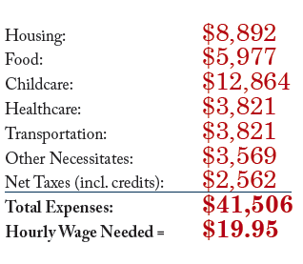
How Much Income Is Required for Self-Sufficiency?
The Cost of Living for Families in Marion County, IN
One Adult, One Preschooler, and One Schoolage Child
Notes:
You can see here that the wage required for self-sufficiency in Marion County – for this particular family type – is well above the median hourly wage of $15.10 per hour.
Again, self-sufficiency is generally defined as 200 percent FPG. Because the Standard measures self-sufficiency by County, the range for self-sufficiency is anywhere from 270 percent of FPG in Hamilton County (nearly $50,000 annually) to 144 percent of FPG in Vermillion County (just over $26,000 annually).

Slide 10
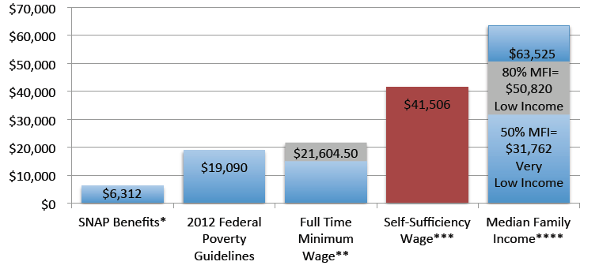
Self Sufficiency Wage Compared to Other Benchmarks 2009-2011, One Adult, One Preschooler, and One Schoolage Child, Marion County, IN
Supplemental Nutrition Assistance Program (SNAP) Benefits: The maximum benefit for a family of 3 is $6,312--the maximums haven’t changed since 2009.
Full Time Minimum Wage: 2080 hours for full-time work by federal minimum wage of $7.25 per hour = $15,080. After payroll taxes and tax credits (totaling $6,524.50), the grand total = $21,604.50.
Self Sufficiency Wage: This number is based on a combination of expenses from the Institute’s 2009 Self-Sufficiency Standard and NCCP’s Basic Needs Budget.
Median Family Income: The U.S. Department of Housing and Urban Development (HUD) uses area median family income as a standard to assess families’ needs for housing assistance.
Notes:
You can see just how low the FPG is compared to self-sufficiency, and that folks earning minimum wage, are not earning NEARLY enough for self-sufficiency.

Slide 11
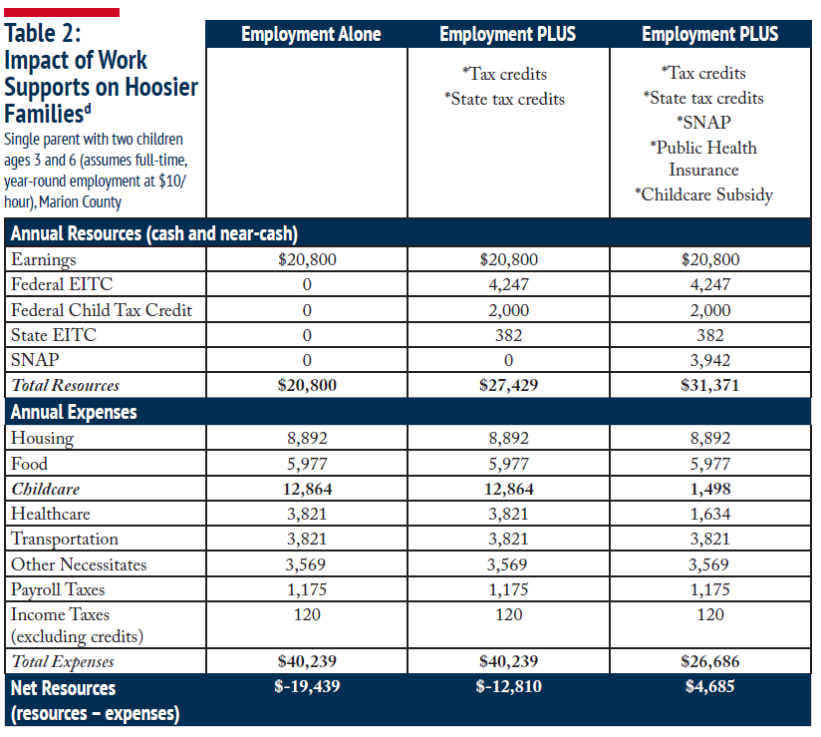
Often Times, Work Isn’t Enough
Notes:
The idea that work alone is does not pay is highlighted here….
And the importance of policy tools (such as tax credits and work supports) to bridge the gap between low wages and the increasing costs of basic necessitates are key to providing opportunity for upward mobility.

Slide 12
Work Supports…
“Credits like the EITC (Earned Income Tax Credit) and CTC (Child care Tax Credit) have helped to reduce poverty, provide economic security, and offset declining labor-market opportunities for low-income workers. The EITC alone is responsible for raising 6.6 million people out of poverty, (including 3.3 million children).” Brookings Institution
Help bring families closer to self-sufficiency by bridging the gap between low-wage work and the increasing costs of basic necessities.
Encourage progress in the workforce.
Are good fiscal policy by putting money into the hands of consumers.
Have been proven to effectively lift millions out of poverty and put them on a path towards self-sufficiency.
Notes:
The Institute’s position is that work is and always will be the best ticket out of poverty, and everyone has a responsibility to find work and support themselves. At the same time, we have a responsibility to ensure that hard work and initiative are rewarded, and that ladders of opportunity (such as work supports) exist to provide access into the middle-class.
Unfortunately, these programs are not working as they are intended in Indiana, and instead, are creating disincentives toward economic mobility, or leading to a situation in which the parent or guardian is working harder, but is financially worse off.

Slide 13
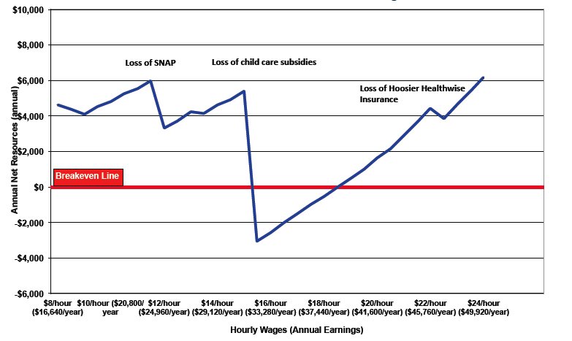
The Cliff Effect One Adult, One Preschooler, and One Schoolage Child, Marion County, IN
Each dollar earned is offset by decreased benefits and higher taxes.
Notes:
Here’s what the Cliff Effect looks like. The red breakeven line is the point in which income is equal to expenses – those basic necessitates. At a wage of $8/hour, a single mother with two children is self-sufficient – with the help of work supports and tax credits.
The first significant loss in net resources occurs when the participant loses SNAP benefits between the wages of $11.50 and $12.00 per hour – a NET loss of more than 10 percent of her annual resources.
Most dramatically though is the cliff that occurs as child care subsidies are lost between the wages of $15 and $15.50 per hour – equal to more than 25 percent of her annual resources.
The choice here becomes clear: remain working or stay at home with the children. With increased childcare costs, the latter is often the most economical -- for tens of thousands of Hoosier families.
Also, it’s important to note that the lack of a cliff for the Earned Income Tax Credit is an example of a program well designed to phase out gradually – which should be the goal for all work supports.

Slide 14
So, What’s Happening Now?
Infographic Video Illustrates Phenomenon
Notes:
Again, with the support of the Indianapolis Foundation - and some folks much more creative than us, we have a short video to illustrate how policy design is acting as a disincentive.
CLAIRE (MAKE SURE THIS WORKS AS HYPERLINK)

Slide 15
Recommendations Making Work Pay & Ending Barriers to Work
Smooth Out Benefit Phase-Outs
A gradual phase-out provides the most basic incentive for hard work – a raise that increases net resources
Change Monthly Income Eligibility Limits
Use an average of six months or one year to more accurately reflect fluctuating incomes due to irregular hours and seasonal employments
Raise Income Tax Threshold
Indiana is among a handful of states that tax residents below the federal poverty line.
Implement Broad Based Categorical Eligibility (BBCE)
Indiana adopted BBCE during the 2011 legislative session, but has yet to implement the rule.
More specific program recommendations in full report
Notes:
As a general recommendation for work-supports as a whole, the Institute recommends those reforms listed here. Recommendations to specific programs can be found in the report. Efforts aimed at reform will not be a sprint, but the payoffs of legislative efforts towards more efficient programs have enormous potential: encouraging financial security and promoting self-reliance; acting as a job creation measure; and restoring the promise of upward mobility for tens of thousands for Hoosier families.

Slide 16
Contact Info
Website: www.incap.org/iiwf
Twitter: https://twitter.com/INInstitute
Facebook: www.facebook.com/IN.Institute
Blog: www.iiwf.blogspot.com
Text: 22828 to ININSTITUTE – to be added to our email list.
Derek Thomas
dthomas@incap.org
(317) 636-4232
(800) 382-9895
Notes:
Say something here….

